Slide 1
NCAA BASKETBALL Team Success VISUALIZATION
BY: Noah Hendricks
CIS 3320
Professor Lendasse
Semester Project Presentation 2 (Tableau)

Slide 2
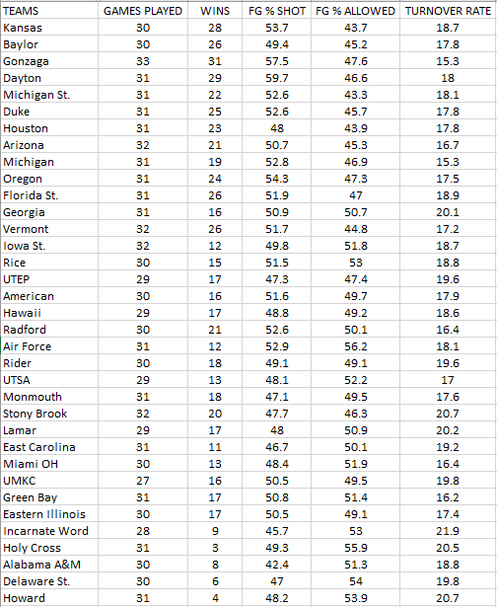
Data/Hypothesis
College Basketball Team Stats
5 Variables
35 Data Points
Reference Link: https://www.kaggle.com/andrewsundberg/college-basketball-dataset?select=cbb20.csv

Slide 3
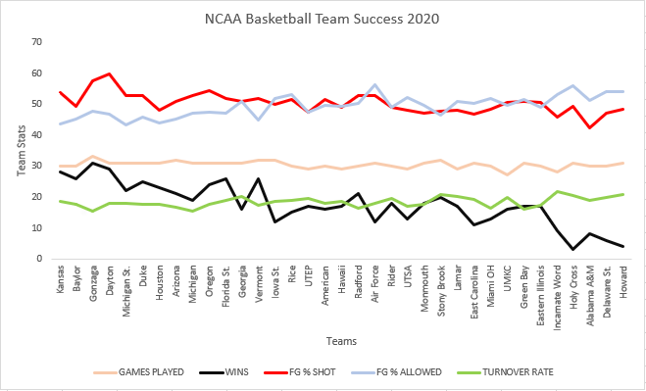
Improved Visualization Using Tufte’s Rules
High Graphical Integrity
High Graphical Excellence
Data Ink Maximization

Slide 4
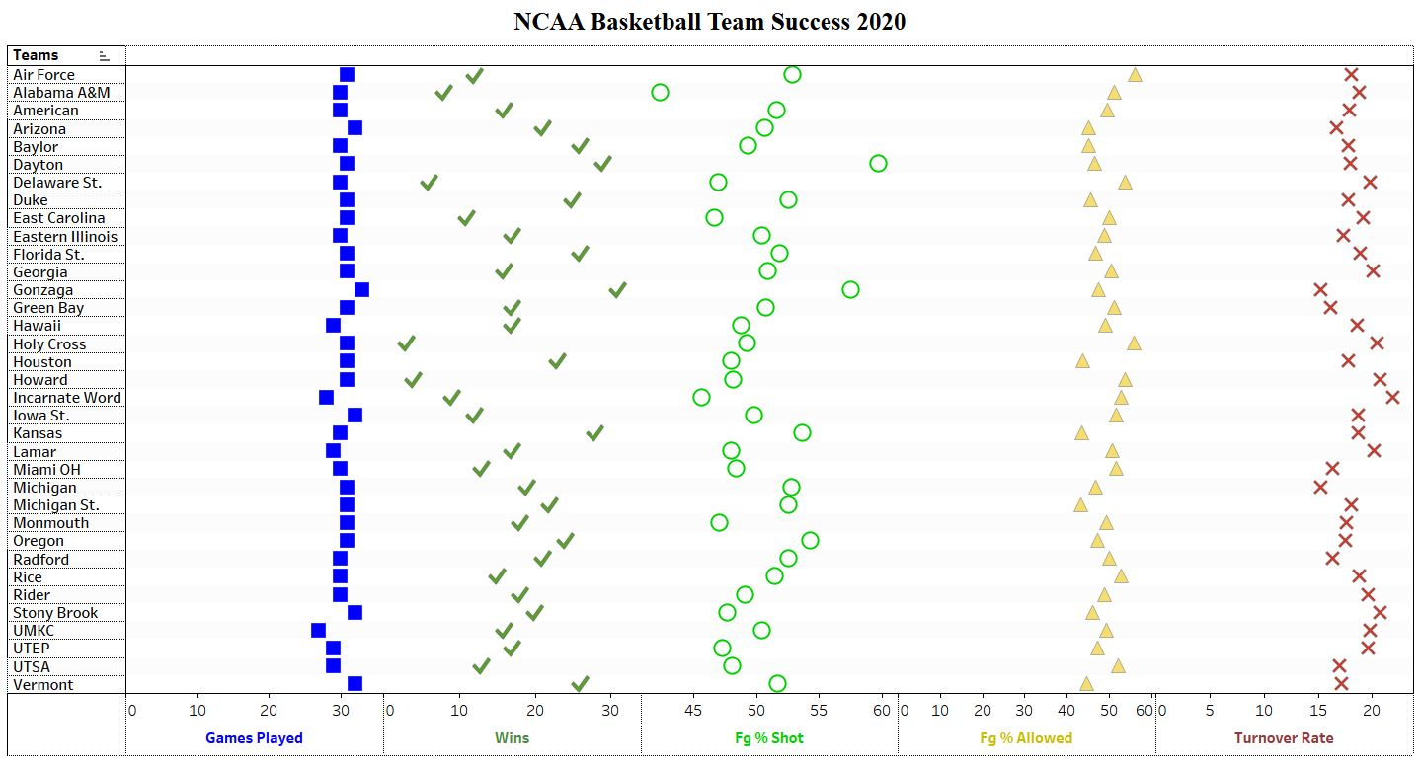
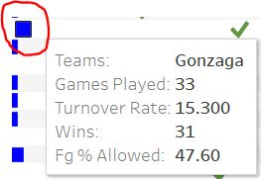
Improved Visualization Using Ware’s Rules
Gestalt Laws
Glyphs
Pre-Attentive Processing
Object-Based Diagrams
Nominal Color Scale

Slide 5
Side By Side View of Both Visualizations
Thank You For Listening!

